Slide 1
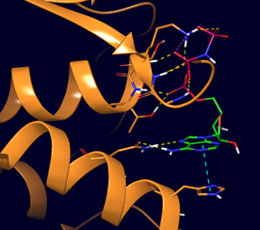
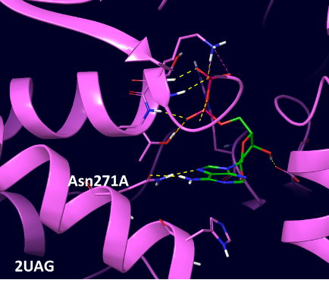
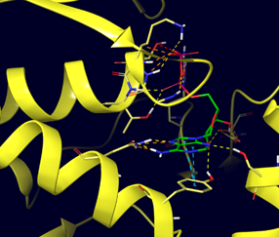
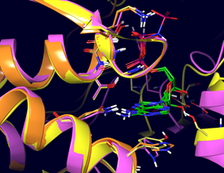
Mur ATP Binding Sites are Well Conserved
Aba murC
Eco murD
Mtb murE
6CAU
2XJA
murC/D/E
Percent identity and similarity of mur ligase ADP binding sites

Slide 2
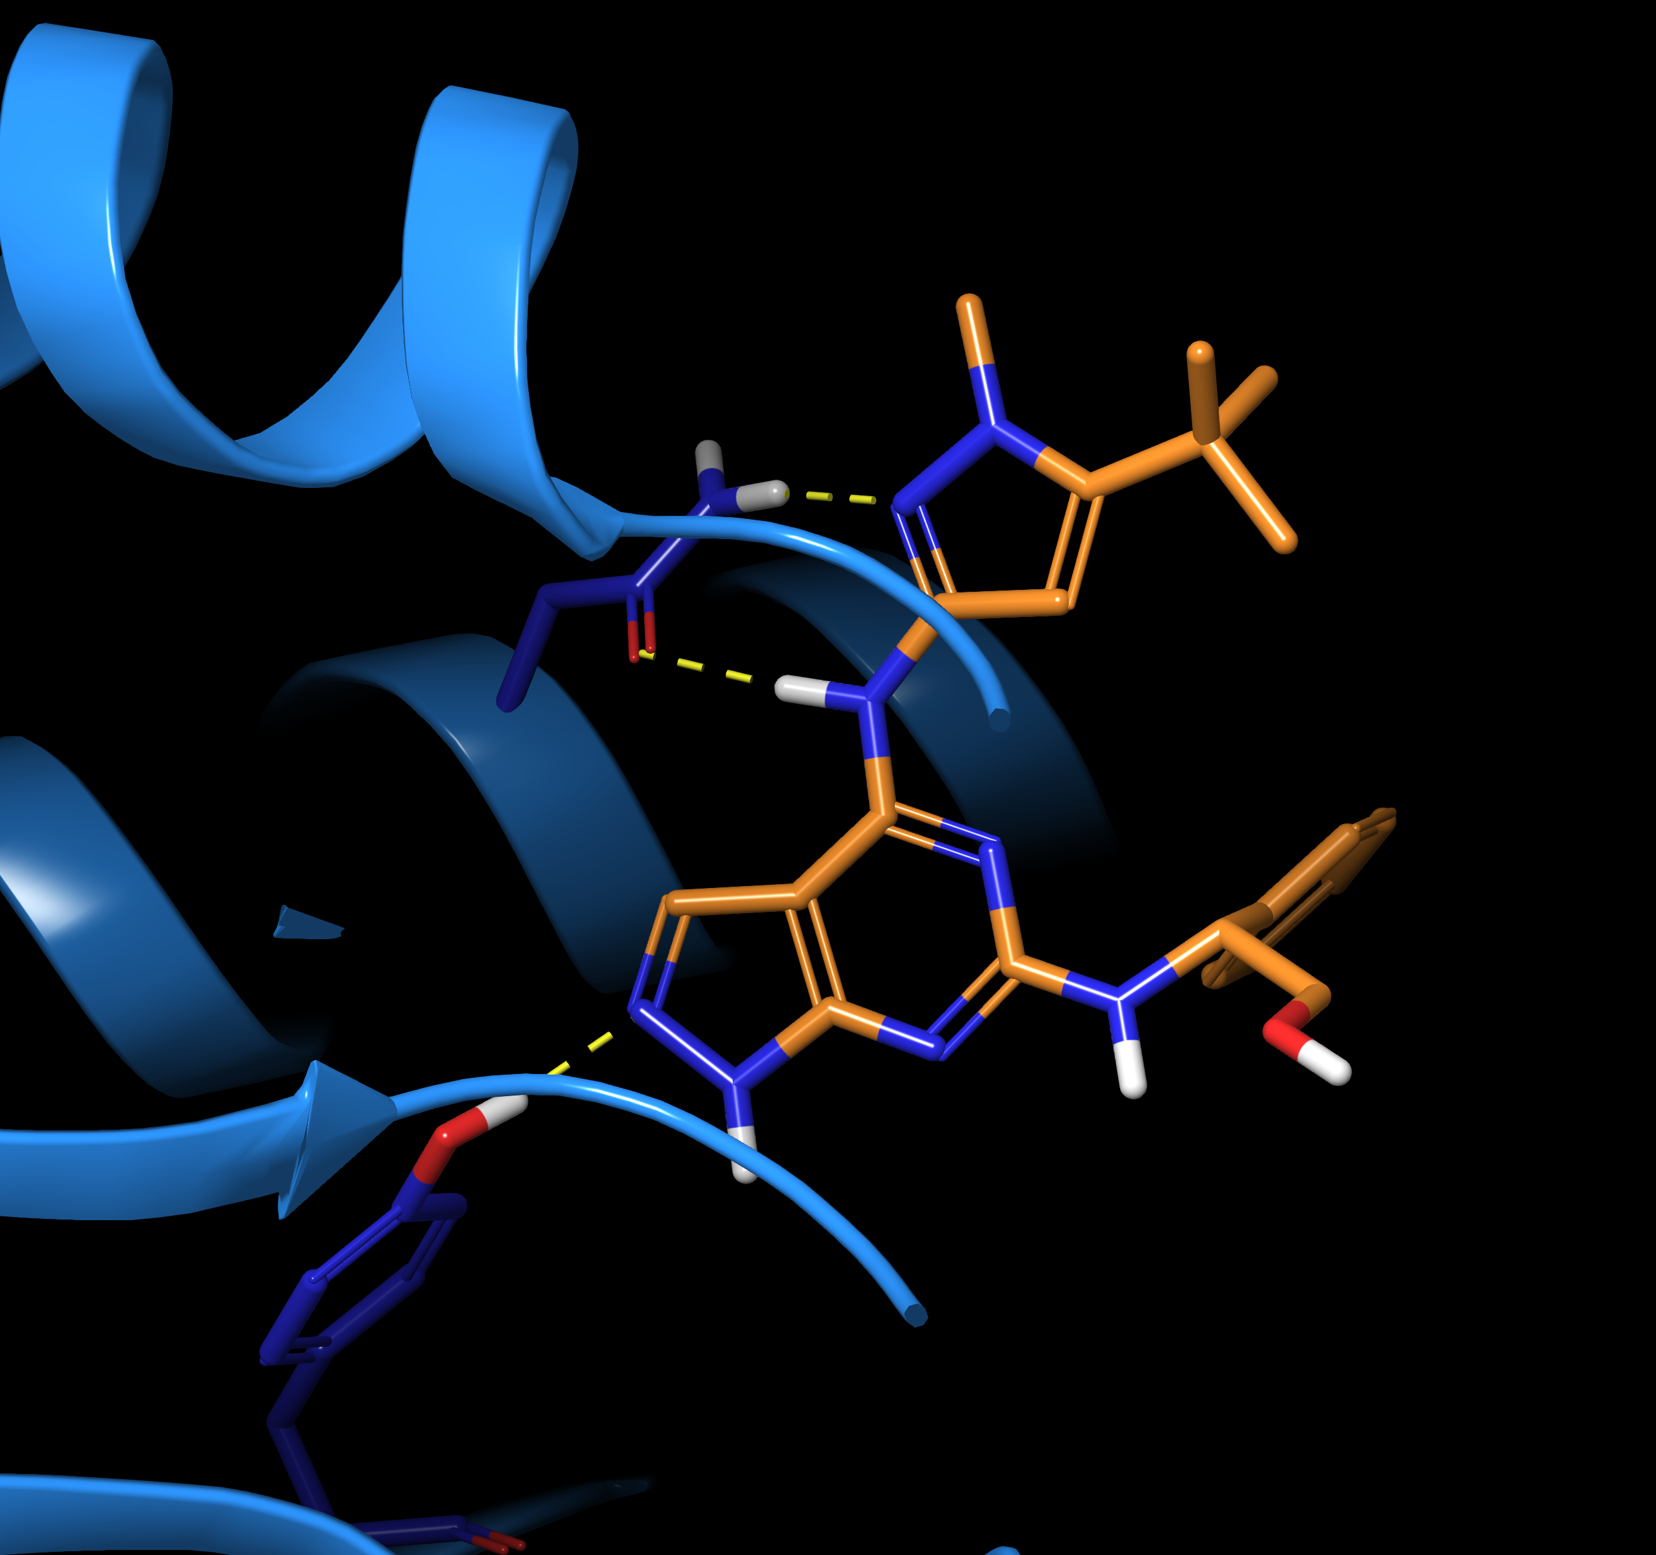

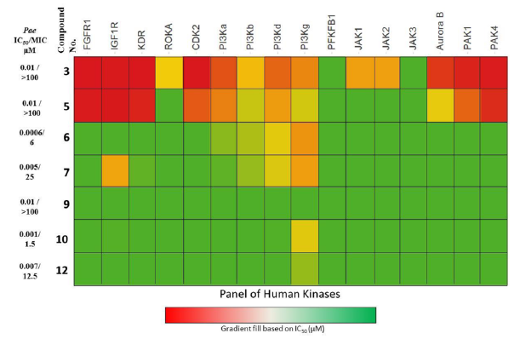
AstraZeneca Pyrazolopyrimidine P. aeruginosa MurC Inhibitors
Solved by SSGCID – released in September 2020
Establishes binding mode – models ambiguous
Confirms ‘kinase-like’ hinge binding mode
Insights for improving potency and modifying physprops
to address poor wild-type Gram-negative MICs
Provides impetus for fragment-based screen of “kinase
hinge binding” chemotypes
Clean human kinase profile:
N292
Pa murC
PDBID: 6X9N
Pae IC₅₀ 1 nM
Pae 545 MIC 1.56 uM (efflux mutant)
Eco 524 MIC 3.13 uM (efflux mutant)
Hameed P, S. et al. ACS Chem. Biol. 2014, 9, 2274−2282 (DOI: 10.1021/cb500360c)

Slide 3
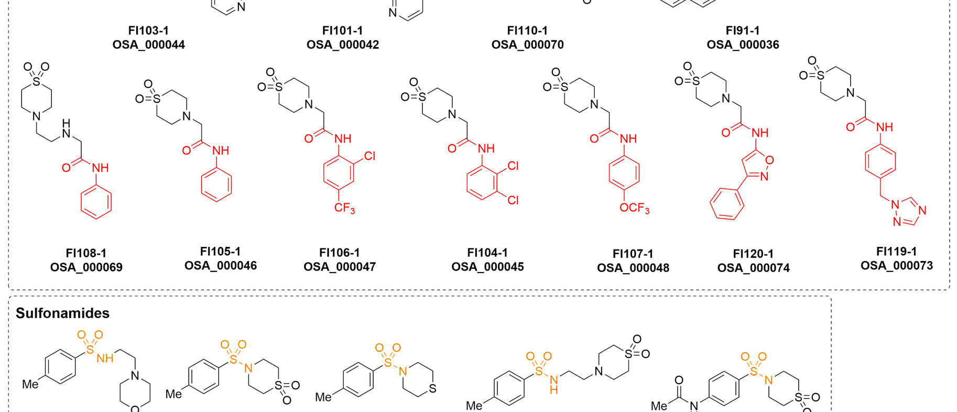
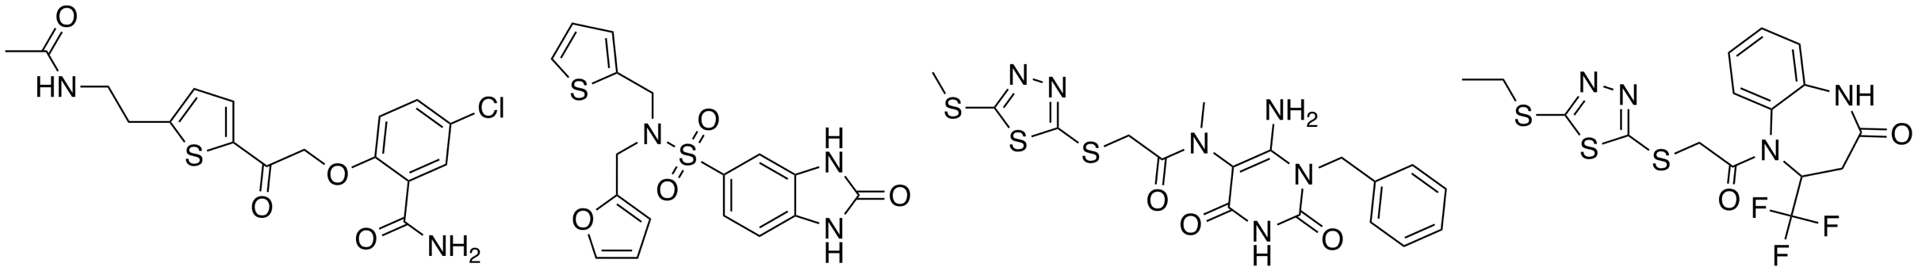
Preliminary Data from our Two Other Approaches
1. De novo design of lead compounds based on fragment screens vs Mur E at Diamond Light Source
2. Pro bono contribution from Atomwise of 92 novel small molecules vs ADP site of Mur E (now being evaluated)
https://github.com/opensourceantibiotics/murligase/wiki/Round-1

